Slide 1
Terms: Bulk Trade, Block Trade, Price bands, Circuit Breaker with examples and impacts on markets
Group 10
Akshat Goel (19ME30064)
Ayush Vajpeyi (17EE10062)
Nihar Joshi (17CH10029)
Utkarsh Pratap Singh (17MT30036)

Slide 2
Bulk Trade
Definition
Rules for Bulk Trading
Reasons for Introduction
Effects
Examples

Slide 3
Definition
A bulk deal is a deal where the total quantity of shares bought or sold is greater than 0.5% of the share capital of the company.
A bulk deal can be transacted either through the normal trading window or through the block trading window.
In bulk selling, the sliced approach helps firms get a better selling price. Bulk deals have to be reported to the exchange by the broker executing the trade. In case the bulk deal (exceeding 0.5% of the share capital) is executed through the block window then the trade has to be reported immediately to the exchange.

Slide 4
Rules of bulk trading
1. Brokers facilitating the trade are obligated to notify the particular exchange about the deal.
2. They must inform the exchange within an hour of the trading day’s closing, especially if the deals are done via a single transaction.
3. Brokers need to provide specific details about the deal such as the script bought or sold, the name of the client, the quantity or volume of shares bought or sold and the trade price.
4. Brokers must also make the information public, after the trading hours close, on the same day of implementing the trade.
5. Bulk deals must mandatorily result in delivery. Buyers/sellers are also required to pay a Securities Transaction Tax (STT) on bulk orders

Slide 5
Reason for introduction
Before these guidelines for disclosure of Bulk deals and Block deals was issued, such transactions were completed in secrecy. Apart from the parties involved i.e. the buyer and the seller, no information on block deals was available to retail investors and rumours about the size of the deal used to drive up the stock price on subsequent days.
The introduction of the Bulk Deals and Block Deals is therefore considered very good as it gives greater transparency and is basically meant to clarify and explain the reason for the increase in volumes.

Slide 6
Effects
Bulk deals indicates the concentration of interest. (Positive/Negative impact on share prices)
Provides a clear picture of the individuals who have invested into the company.
A study of the bulk deals between institution and promoters provides a long term perspective on the stock. (Most of the bulk deals indicate absolutely nothing, they happen because of high frequency algorithmic traders who place large buy/ sell orders)

Slide 7
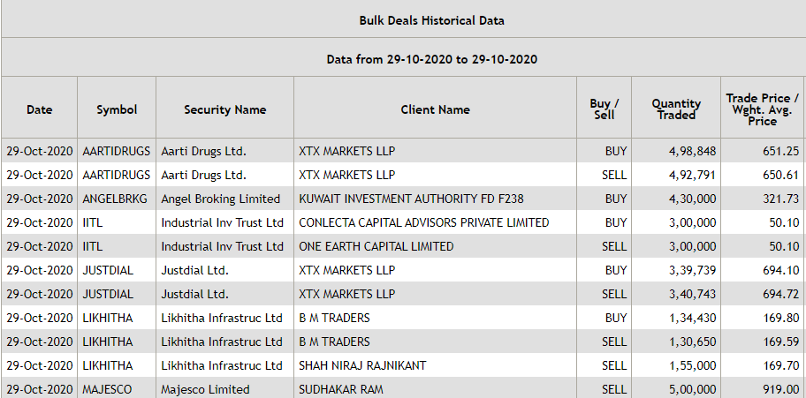
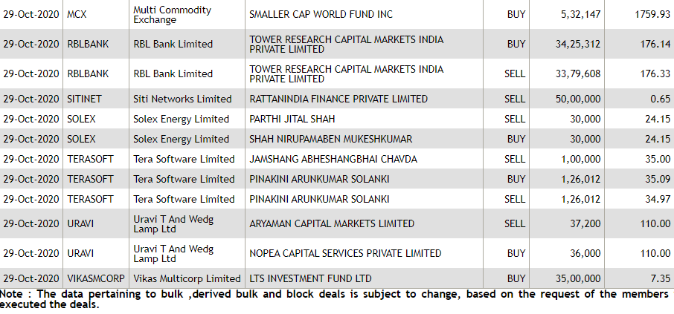
Bulk Deals on 29th October, 2020

Slide 8
Examples
On 4th November, 2019 Rakesh Jhunjhunwala bought 1.30 crore shares or 0.51% stake in private lender Yes Bank Limited via open market transactions. The shares were bought at a price of Rs 67.1, taking the transaction to Rs 86.89 crore.
This led the stock price to increase nearly 9% on the following day, after 2 days of consecutive fall. This led to reinstate the retail investors’ faith in the lender.

Slide 9
Block Trade
Definition
Rules involved in block trading by SEBI
Effects on market and investors
Recent examples

Slide 10
Definition
A block deal is a deal in the sale and purchase of a large number of securities generally by the institutional investors at an arranged price between the 2 parties. In general it involves at least 5Lc. shares or minimum value of 5Cr. as per SEBI rules.
A block deal can be transacted even outside the open market through a private purchase agreement to lessen the impact on the security and cannot be detected in the normal trading window by a retail investor.
These block deals are done through different brokers to mask the true size of the deal.
SEBI states that that block deal orders should be placed for the price not exceeding +1% to -1% of previous day’s closing or at CMP(Current Market Price).

Slide 11
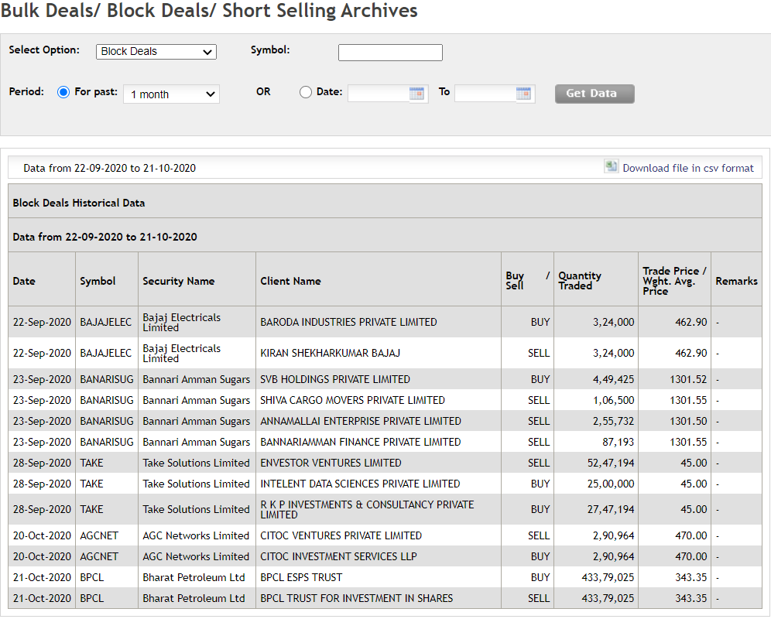
Block deals data of past 1 month...

Slide 12
Rules of block trading...
1. An order may be placed for a minimum quantity of 5La. shares or of 5Cr. in value and this rule by SEBI is with effect from 2/09/2005 and before it the definition was of >0.5% of the equity shares of a company.
2. Every block deal has to result in delivery and “Block deal” orders cannot be squared off or reversed..
3. According to rules by SEBI the block deals can be executed only 2 times in a trading session day i.e. morning block deal session( 08:45 AM to 09:00 AM.) and afternoon block deal session( 02:05 PM to 2:20 PM.)
4. The stock exchanges shall give information on block deals such as name of the script, name of the client, quantity of the shares bought/sold, traded price etc. to the public on the same day but after the market hours so it is advised by market experts to not take a trading position on a script on basis of a block deal.
5. The orders may be placed in block deal window at a price not exceeding +1% or -1% from previous day closing price or current market price.

Slide 13
Effects on market and investors
Impact on the investors completely depends on three factors:-who sold the shares, reason for selling the shares and who bought the shares.
If the shares were pledged by the promoters and were offloaded by the creditors then it means share price may fall further eg. Kingfisher airlines.
If the promoter or HNIs(High Network Individuals) want to sell their holdings for some other purposes, then there is short term panic but when the news is out the price stabilizes again eg. Infosys(Narayan murthy).
Sometimes the investors closely watch the buying and selling of the major fund houses and price may shoot up in the sentiment but for short time only and this will also intensify if the manager of fund is also popular like Rajeev thakkar, Madhu kela, Nimesh shah etc.
Also sometimes there may be a short shot up in price if any major HNI like vijay kedia,rakesh jhunjhunwala,damani ji etc. is buying any shares in his/her portfolio as they are generally considered to make profitable investments.

Slide 14
Examples of block deals...
Kotak Mahindra Bank Ltd’s promoter Uday Kotak on June 2, 2020, sold 56 million of his shares of the bank for at least ₹6,913.75 crore through a block deal in an effort to reduce his stake in the bank to 26.1 per cent, close to the promoter-holding level as allowed by the RBI licensing rules of 2015( In it a promoter of a private bank is required to reduce the holding to 40% within 3 years,20% within 10 years and 15% within 15 years of since operations started).
Cross holdings between the Ambani brothers in 2005 was completed through block deal platforms of recognised stock exchanges in India.

Slide 15
Differences between Bulk and Block Deals
Bulk Deals | Block Deals
Total quantity bought or sold is more than 0.5% of the total number of shares of the company. Can be transacted in slices, throughout the day. Bulk orders are visible to everyone. | Involves a minimum quantity of 5,00,000 shares or minimum value of Rs. 5 crores Executed through a single transaction, on the special “Block Deal window”. Not shown to the people who trade from normal trade window

Slide 16
Price bands
Context
Definition
Examples &
Effects on market

Slide 17
2 scenarios
Price bands
Price bands in IPO
L/U Price bands

Slide 18
Price Bands in IPO
A price band is a value-setting method in which a seller indicates an upper and lower cost limit, between which buyers are able to place bids.
The price band is used during the price discovery stage of an initial public offering (IPO), decided by looking at the company’s valuation and future prospects.
The price band and the minimum bid lot of an initial public offer (IPO) is decided by the promoters or selling shareholders of a company in consultation with the book running lead managers (BRLMs).

Slide 19
Example of a Price Band in IPO
Bid Price | Number of shares | Cumulative shares | Cumulative % of total shares
₹62 | 2500 | 2500 | 25%
₹61 | 1500 | 4000 | 40%
₹60 | 3000 | 7000 | 70%
₹59.5 | 1600 | 8600 | 86%
₹59 | 1400 | 10000 | 100%
₹57 | 2000 | 12000 | 120%
₹56.5 | 2400 | 14400 | 144%
₹56 | 1000 | 15400 | 154%
₹55 | 1600 | 17000 | 170%
Example of how underwriters use the price band to build the books.
Imagining a company who wants to issue 10,000 shares in its IPO, and the price band is set at ₹55 to ₹62.
The bids that are received from investors are:

Slide 20
Example of a Price Band in IPO
Bid Price | Number of shares | Cumulative shares | Cumulative % of total shares
₹62 | 2500 | 2500 | 25%
₹61 | 1500 | 4000 | 40%
₹60 | 3000 | 7000 | 70%
₹59.5 | 1600 | 8600 | 86%
₹59 | 1400 | 10000 | 100%
₹57 | 2000 | 12000 | 120%
₹56.5 | 2400 | 14400 | 144%
₹56 | 1000 | 15400 | 154%
₹55 | 1600 | 17000 | 170%
No. of shares issued by company - 10,000
Total bids submitted - 17,000 shares.
The highest price at which the company is able to sell its issue (Cutoff price)- ₹59
All bidders below ₹59 on the price band will have their money refunded and will not be allocated any shares.
Bidders who submitted prices at ₹59 or more will receive shares for ₹59.

Slide 21
L/U Price Bands (In money control)
Price band is a price range within which the stock can be traded. Thus, safeguarding sets to prevent large moves in the stock in a very short time.
Lower Price Band / Lower Circuit - Minimum limit at which stocks can be traded
Upper Price Band / Upper Circuit - Maximum limit at which stocks can be traded
The exchange will not accept orders that are set outside the lower and the upper of the price range and if the price drops to the upper/lower price band trading will temporarily stop for that entire day.

Slide 22
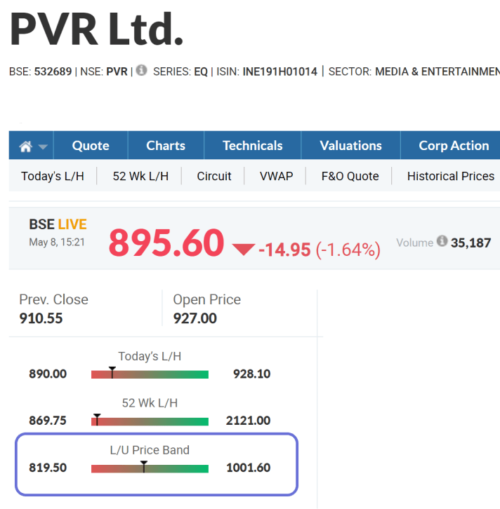
Example of L/U Price Bands
L/U Price Band Calculation
L/U Price band for PVR - 10%
10% of the previous closing price 910.55 is 91.05.
Upper circuit price
910.55 + 91.05 = 1001.60.
Lower circuit price
910.55 – 91.05 = 819.50
The Price of PVR Cinemas on this day, cannot go below 819.50 or above 1001.60.

Slide 23
Who decides the price bands?
The NSE & BSE have set price bands for all shares.
Daily price bands are applicable on securities as below:
A stock can have price bands at 2% either way, based on the previous day's closing price.
A stock can have price bands at 5% either way, based on the previous day's closing price.
A stock can have price bands at 10% either way, based on the previous day's closing price.
A stock can have price bands of 20% either way, based on the previous day's closing price.
No price bands are applicable on scrips on which derivative products are available

Slide 24
Advantages of Price bands
Prevent extreme price movements that are not warranted by any news or development or are a rumour
They reduce the scope for price manipulation
Eg. - Operators who have large funds/shares aiming to rig the prices would be able to move only to the extent the daily (and trading cycle) price bands allow them to

Slide 25
Disadvantages of Price bands
Price bands are not so effective in long term scenarios.
Eg. - If the operators have time at their disposal, they can manipulate prices to desired levels gradually.
Price bands can be ineffective in cases, and can even create new problems for investors, when a stock touches the lower / upper circuit limits.
Downward trend - There may not be buyers in a sharp downtrend because they believe the stock is headed still lower. As a result, investors wanting to sell the stock won't find buyers at the lower circuit price.
Upward trend - Likewise, when stocks hit the upper circuit, interested buyers may find no willing sellers (who are convinced they can get a better price by waiting for the stock to rise further).

Slide 26
Circuit Breaker
Meaning
Examples &
Effect on Market
Advantages and Disadvantages

Slide 27
Definition
Circuit Breakers are predefined values in percent terms, which trigger an automatic halt or check when there is a runaway movement in stock markets in either direction.
Circuit breakers are employed for both stocks and indices
The runaway movement impacts the monies of investors in either case, if market falls by certain percentage or it rises, so it becomes incumbent to halt the market

Slide 28
What happens during a circuit breaker
Halting of trade in a security or index for a certain period
Happens when there is not minimal but appreciable change in indices or stocks, following uncertainties in news
Halting here helps the news to get absorbed among the investors if there is any confusion related to the news
Happens more frequently
Halting of trade in a security or index for an entire trading day
Happens when there is an uncontrollable change, then it becomes prudent to close the market for a whole trading day
Happens less frequently

Slide 29
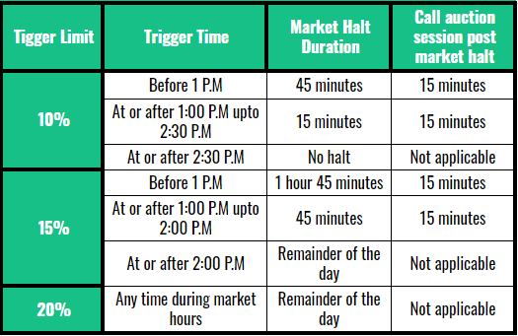
3 stages of market wide Circuit Breakers

Slide 30
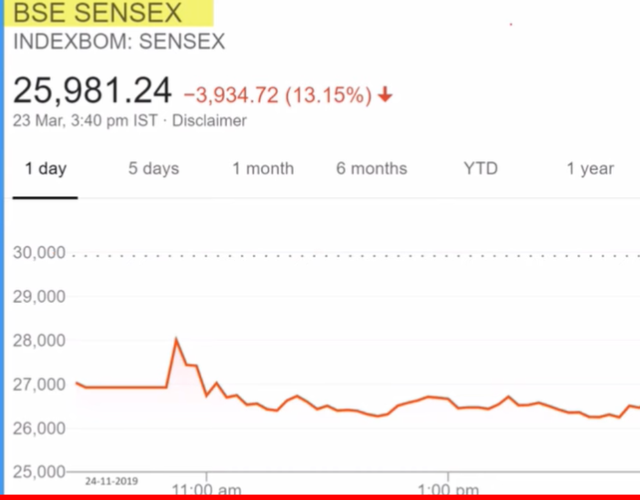
Case of Lower Circuit halt
Circuit Breaker Initiated
Previous Close: 29915.96
26,924.36
This is a snip of the circuit break that happened on 23 March 2020. Market started at 9:15 am, and observed a sudden dip of 10%, so the market was put in halt for an hour, from 9:40 till 10:40 am.
Notes:
After opening the market once again, the market saw a dip of 13.15 %. Had it been more than 15 %, the rule of halting for 2 hrs would kick in eventually.

Slide 31
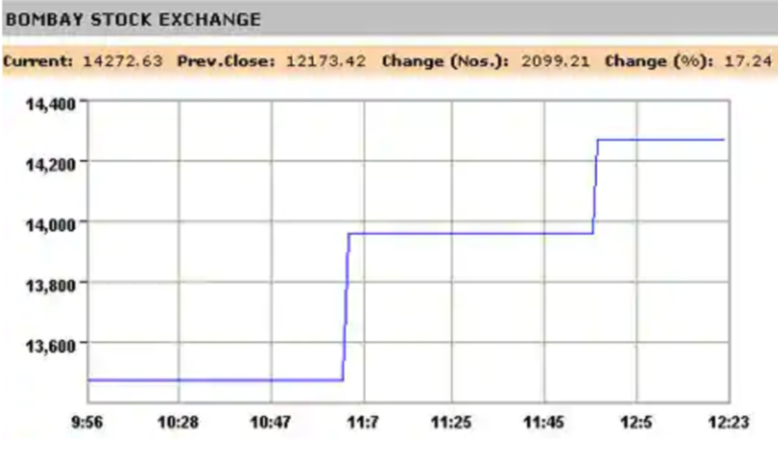
Case of Upper Circuit halt
Here in this case, Markets hit the upper circuit(where the halt was because of the spike in positive change observed) twice, happened on 18 May 2009, where the markets saw recovery from the financial crisis of 2008 and also because of unexpected victory of UPA

Slide 32
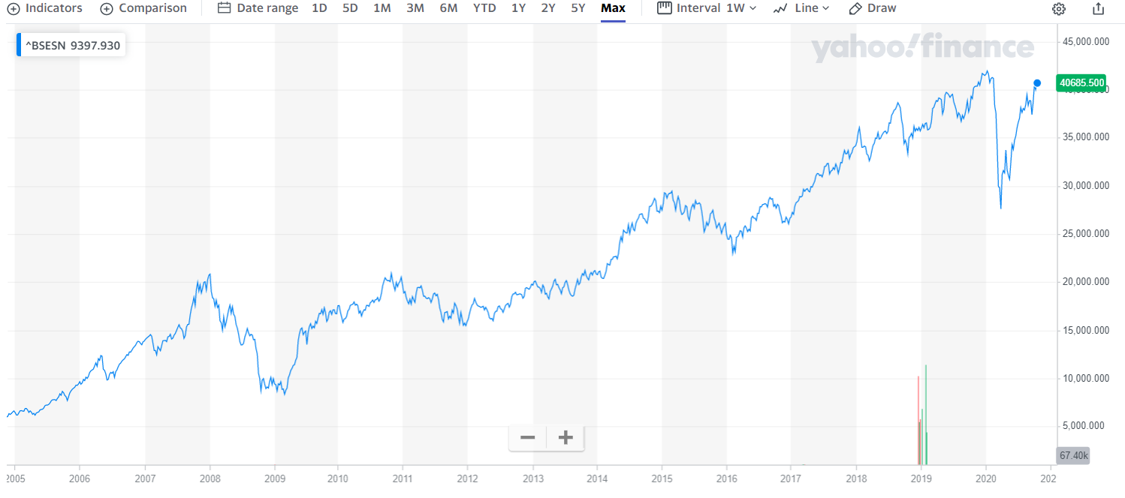
Comparisons with 2007-08 Financial Crisis
More Duration
Less Duration
Notes:
We can see the drop in march 2020, in just a short span of time we saw the dip comparable to that dip around 2008, where it took 3-4 months to see the drop of that extent. In both the cases there was the use of circuit breaker.

Slide 33
Key Factors Behind the Fresh Market sell-off during 23 Mar 2020
India under lockdown, companies announce shutdown
Delays in $1 trillion US stimulus
Rupee hits 76 a dollar level, FII(Foreign Institutional Investors) selling intensify
News of confusion that whether India would follow trajectories of China or Italy in battling Covid that time around
Precisely, the market starts behaving abnormally due to the sentiments of the investors which comes from the unprecedented news headlines going around. If the outlook is negative, sell-offs are a consequence and vice-versa. Cases like these are avoided using circuit breakers that help the news to get absorbed among the investors

Slide 34
Advantages and Disadvantages of circuit breakers
Advantages
To stop panic selling following unprecedented news and stopping flash crash
For regulators in a bid to cool down the stock market that’d prevent total collapse like that on Black Monday (October 1987)
Disadvantages
Price discovery mechanism is significantly impacted during the halting period which can lead to Abnormal trading volume and volatility when trading resumes

Slide 35
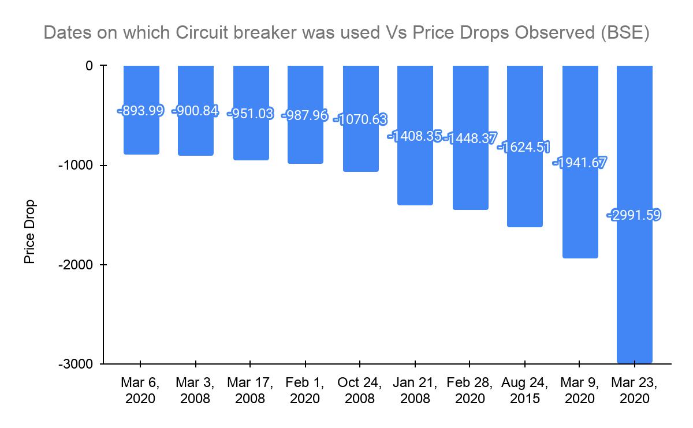
Notes:
Halt observed on 24 Aug 2015 was due to “Flash Crash”

Slide 36
Thank You

